Slide 1
Introduction to psycholinguistics: Investigating linguistic meaning
Session 1
Vinicius Macuch Silva
Cognitive Modeling group

Slide 2
Course schedule
Part I — Foundations of psycholinguistics
Part II — Selected readings
Session 1-7
Session 8-12
(pre-recorded) Lectures
(pre-recorded) Class presentations

Slide 3
Materials - Part I
Twenty-First Century Psycholinguistics
Four Cornerstones
The Handbook of Psycholinguistics
Eva M. Fernandez & Helen Smith Cairns (2018)
Anne Cutler (2005)

Slide 4
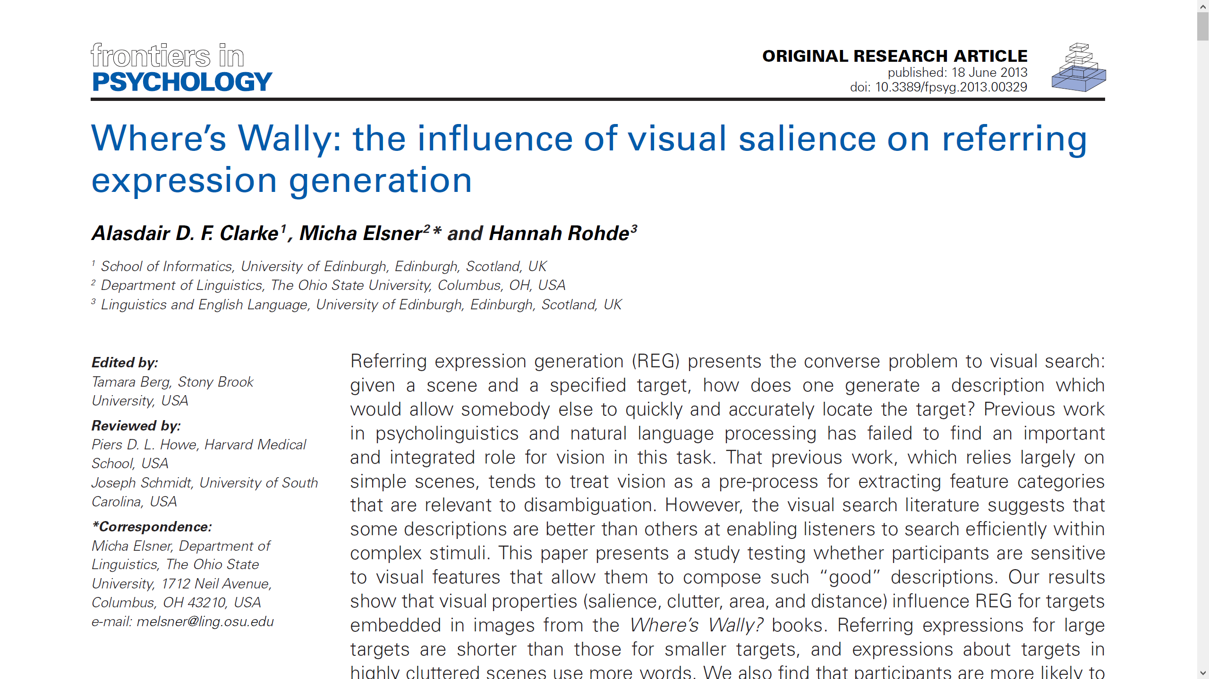
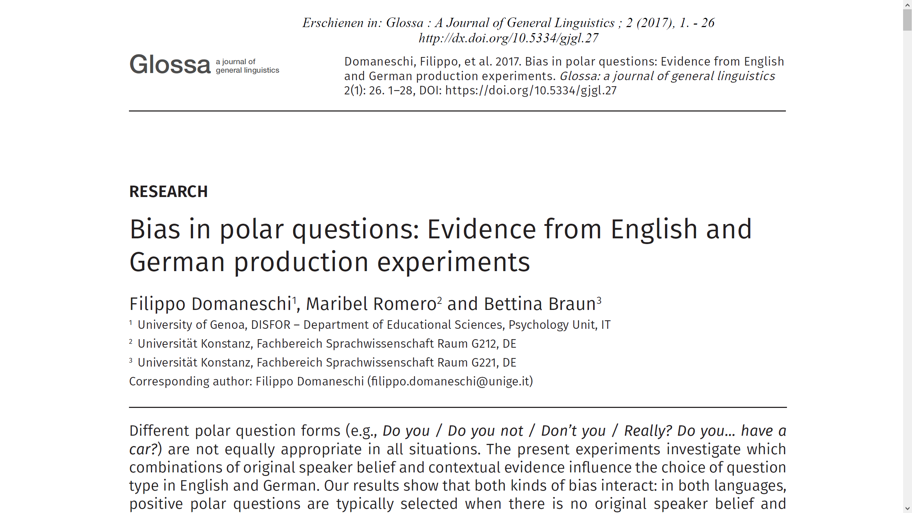
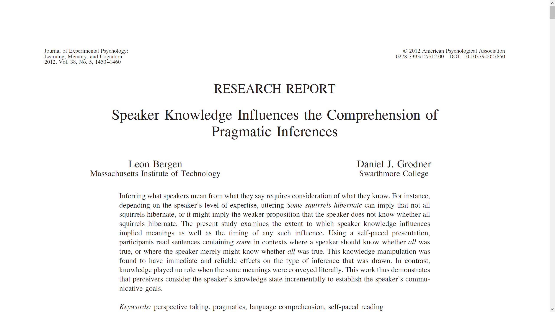
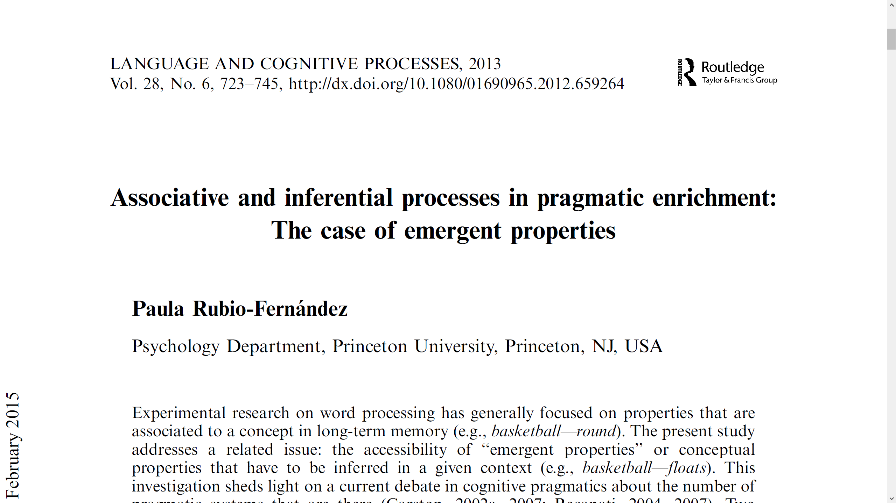
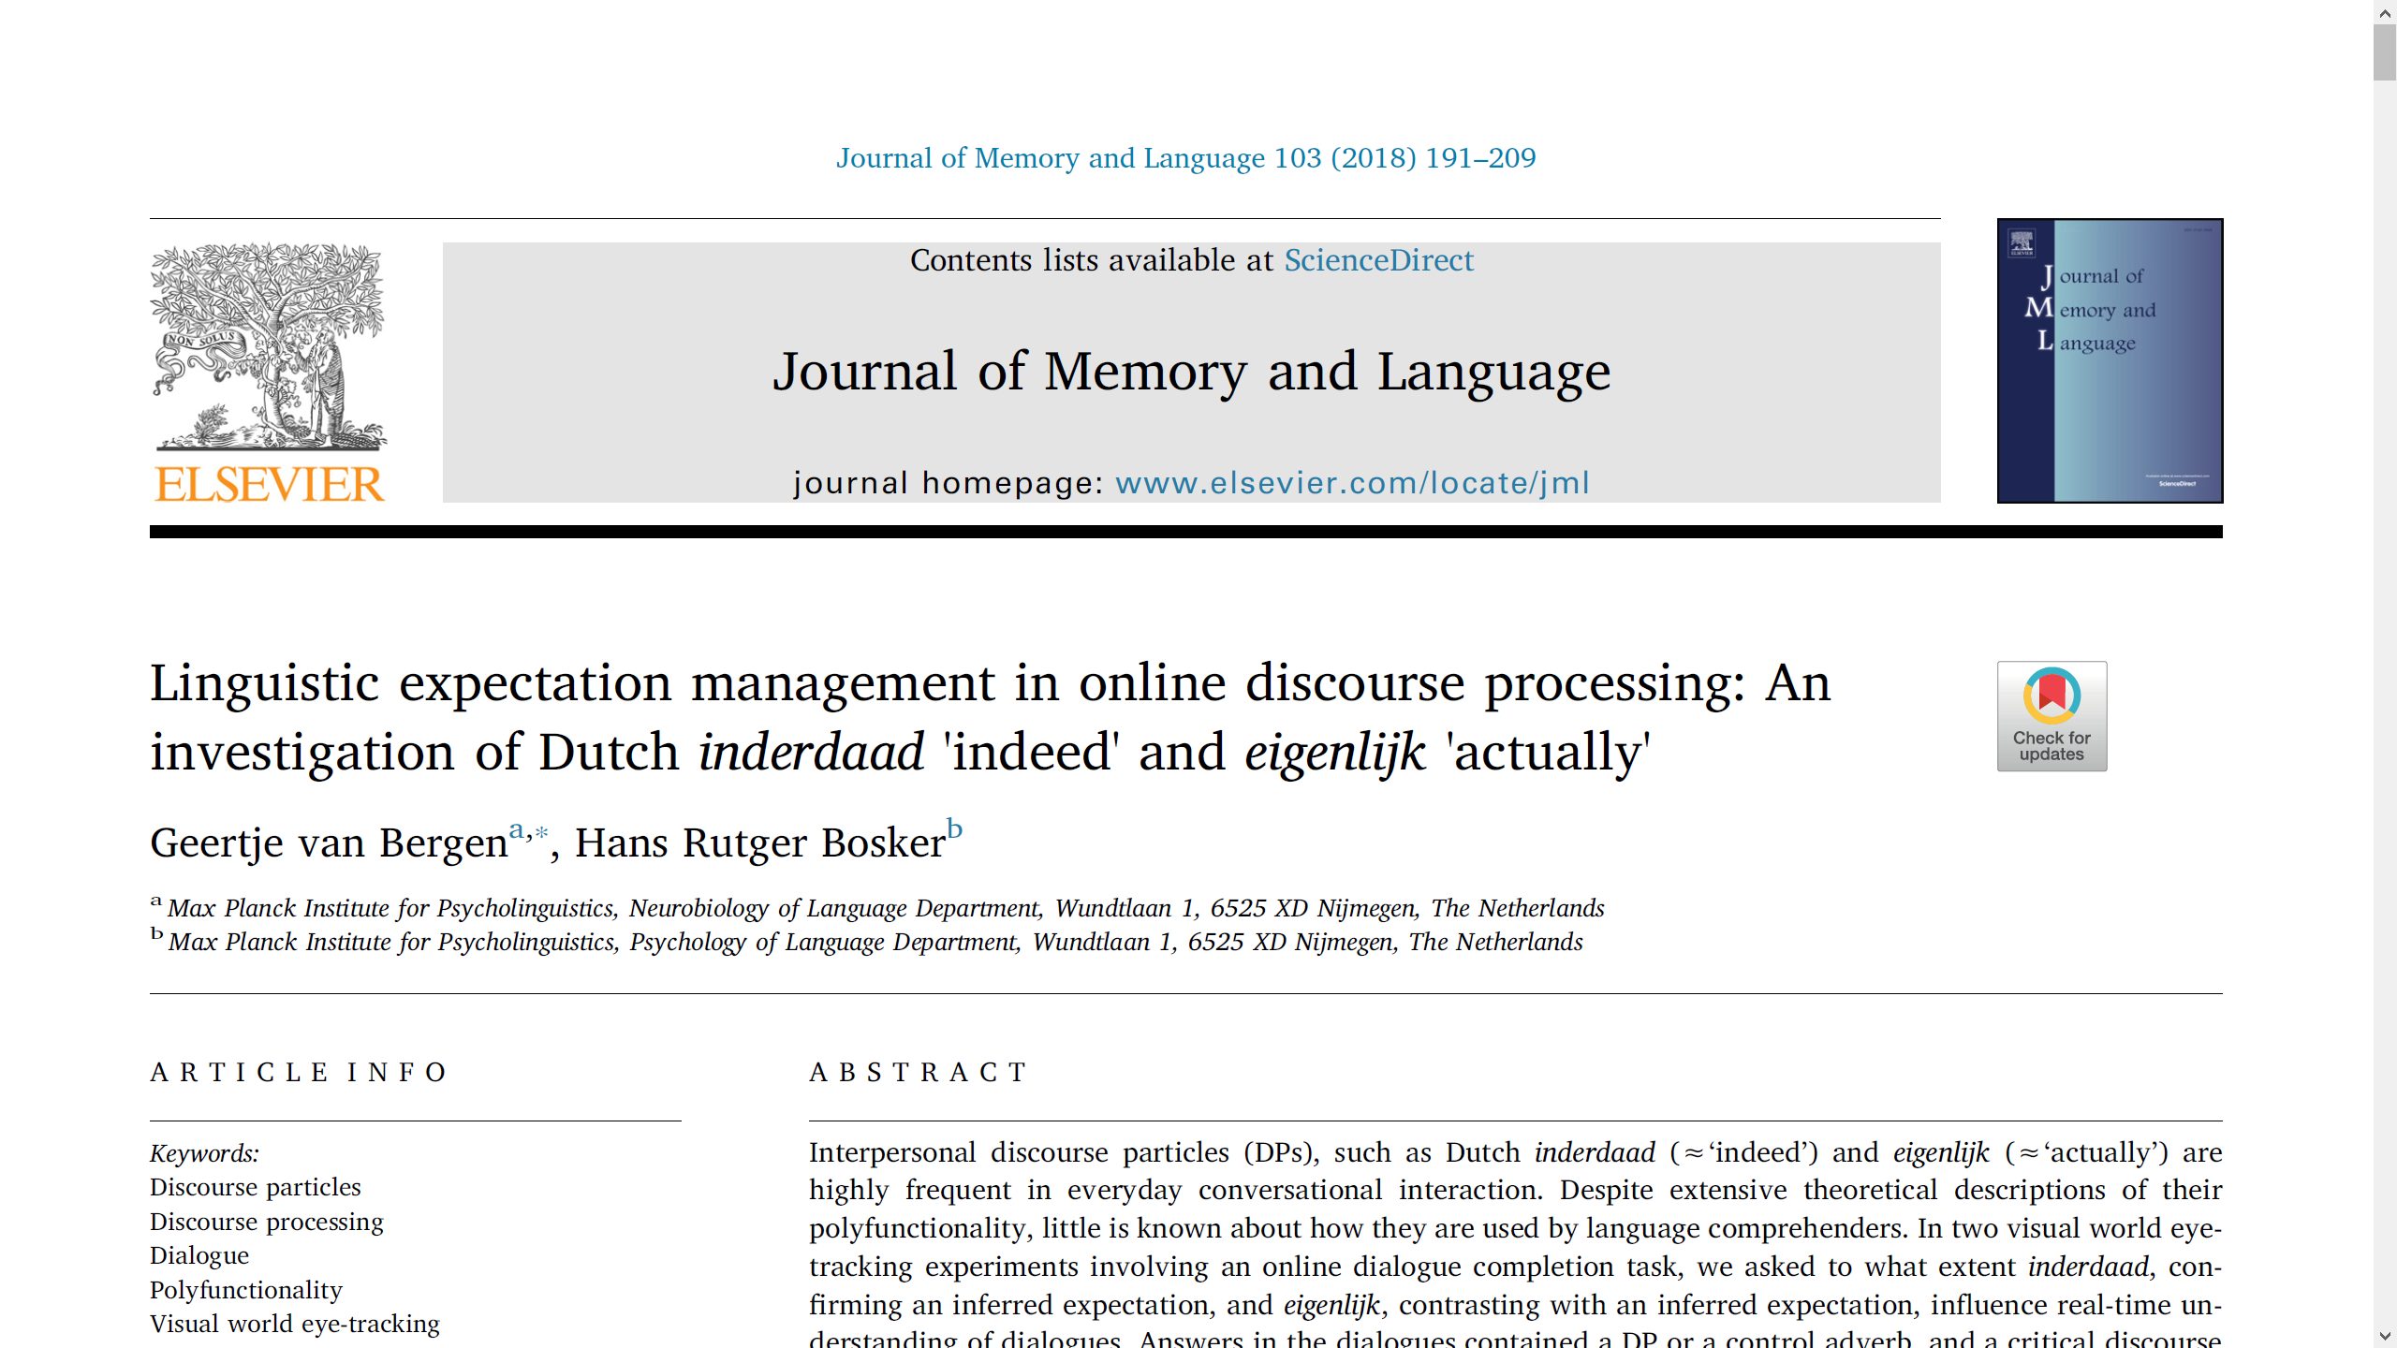
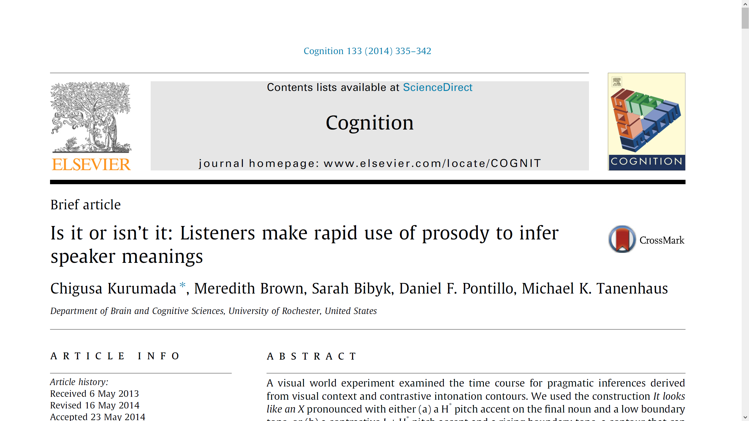
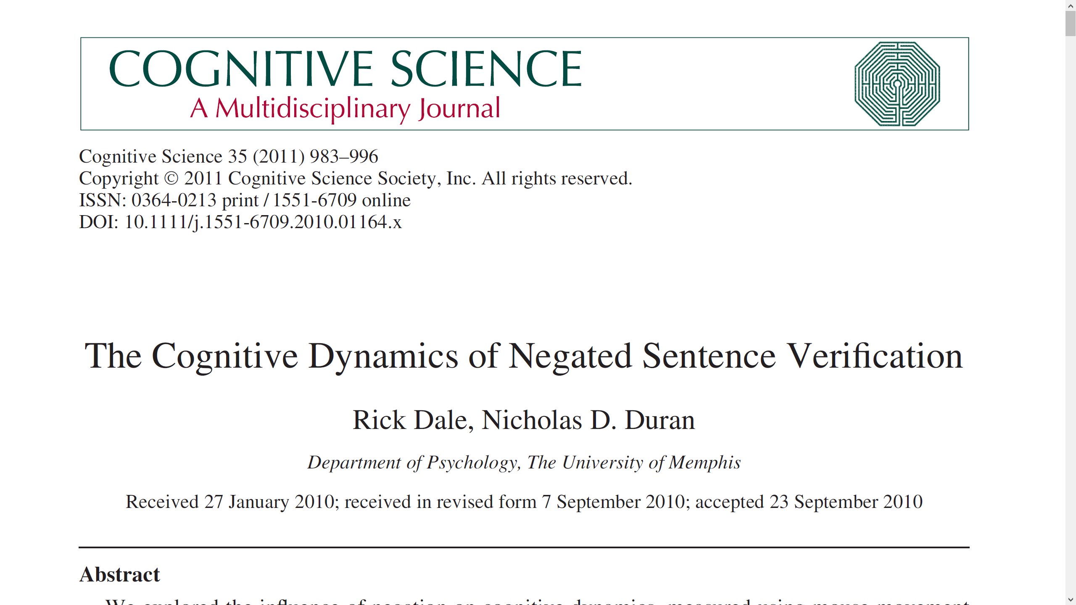
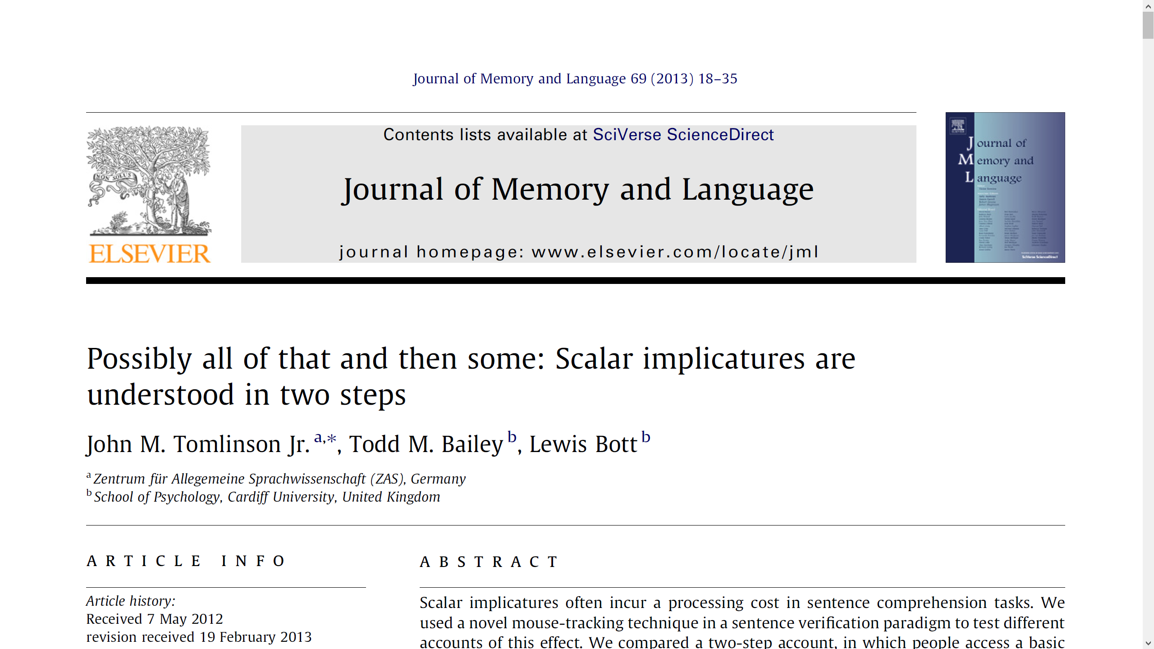
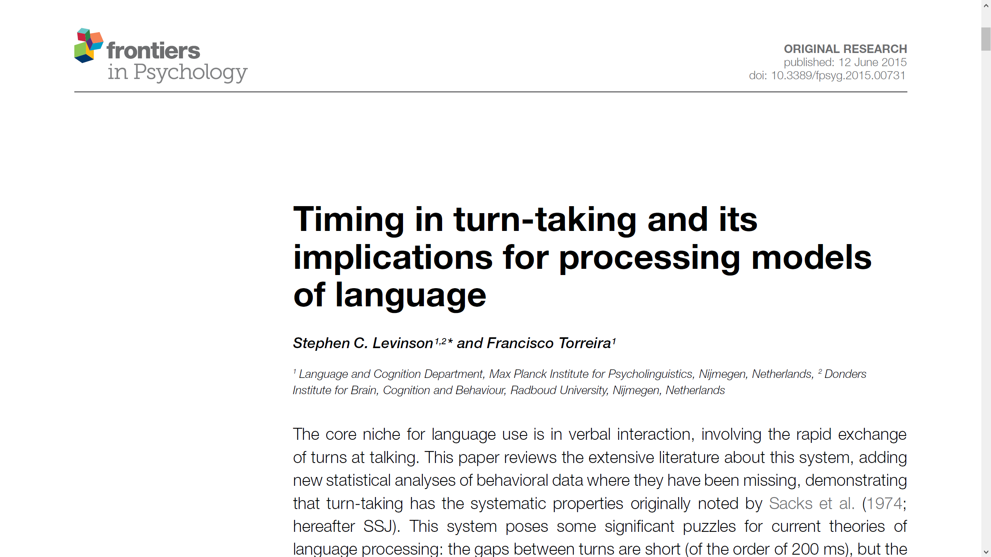
Materials - Part II

Slide 5
Course assessment
One-page summary of 3 sessions
30%
Part I
30%
Presentation of a paper
Part II
40%
Short assignment on a paper

Slide 6
Psycholinguistics: what is it?

Slide 7
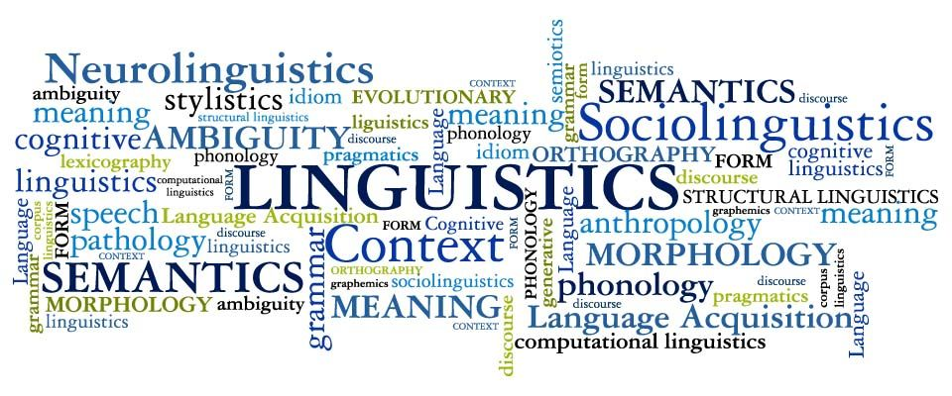

What is psycholinguistics?
Psycholinguistics

Slide 8
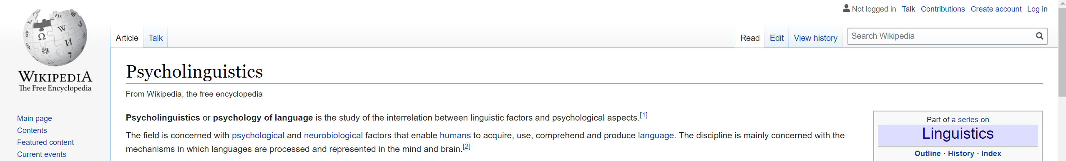
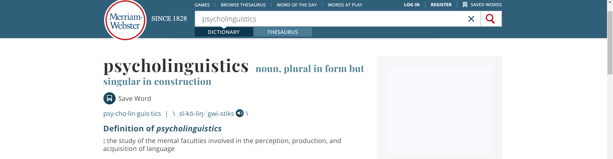
What is psycholinguistics?

Slide 9
What is psycholinguistics?
The study of how humans produce and understand language, and of how we acquire these skills as both first and second language learners

Slide 10
What do psycholinguists investigate?
Language use
Language structure
Psychologist
Psycholinguist
Linguist
Mental structures and processes involved in language use
Patterns in language
Universal characteristics
Language-specificity
Language performance
Laboratory studies

Slide 11
What do psycholinguists investigate?
Mechanisms underlying language use and representation in the human mind and brain

Slide 12
Four cornerstones of psycholinguistics
Psychology & linguistics
Comprehension & production
Model & experiment
Biology & behavior

Slide 13
Psychology, linguistics, and adult language processing
Experimental psychology
Linguistics
Chronometric analysis
Tape recorder
Computer-readable vocabularies/
large language corpora
Programming techniques
(connectionist modeling)
Processing predictions from
linguistic models
Asymmetry btw. psycholinguistic research
and linguistic theory
Psycholinguistic models
(sentence processing)

Slide 14
Psychology, linguistics, and language acquisition
First language acquisition
Second language acquisition
Children learn their native
language(s)
Children and adults learn their
non-native language(s)

Slide 15
Biology and behavior
Language processing in the human organism
Psycholinguistics
Cognitive neuroscience
Cognitive science
Interface btw. language and other cognitive faculties and processses
Language & spatial cognition
(frame of reference)
Spatial reference distinctions in cognitive neuroscience <> spatial codings in language
Language processing in the brain
(Neurolinguistics)

Slide 16

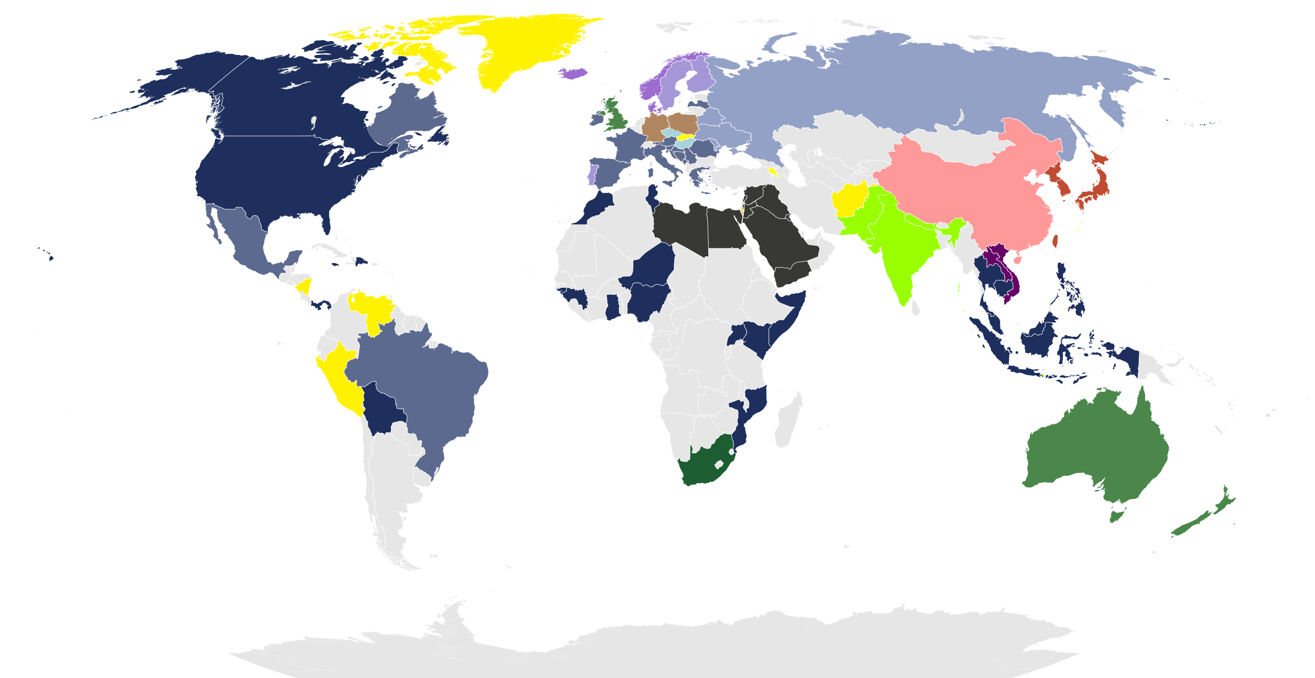
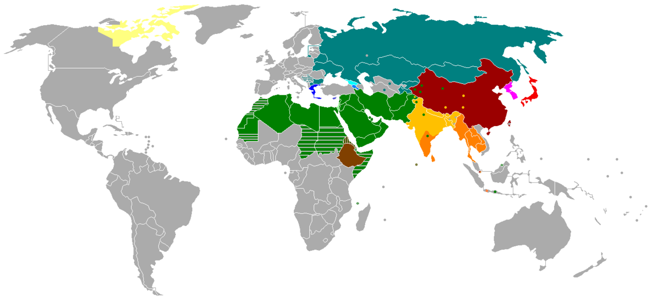


Language modalites & media
Spoken language
Signed language
Written language

Slide 17
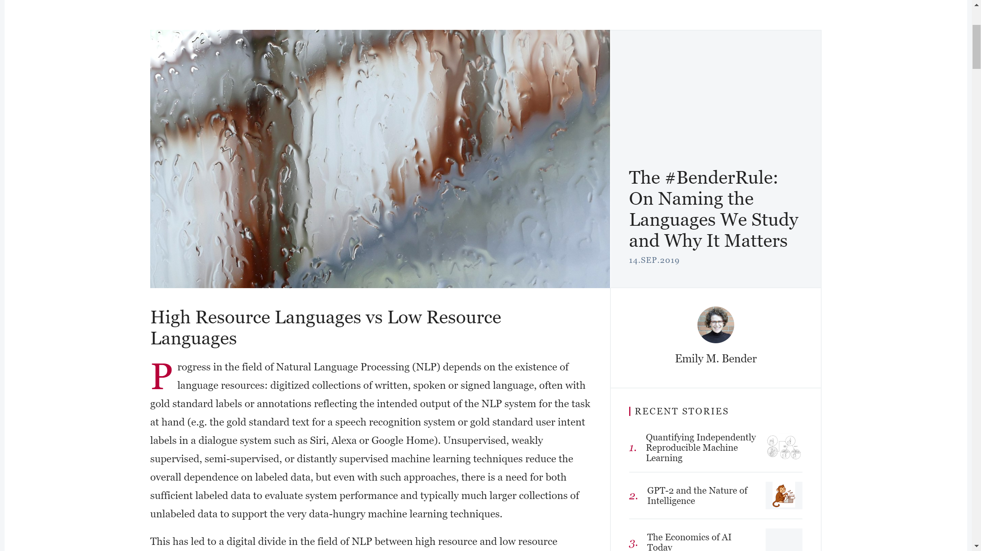
Linguistic diversity!
https://thegradient.pub/the-benderrule-on-naming-the-languages-we-study-and-why-it-matters/

Slide 18
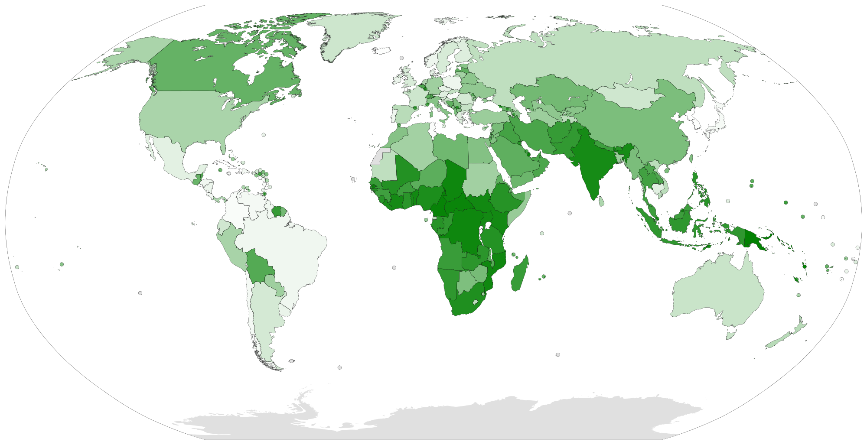
https://commons.wikimedia.org/wiki/File:Ethnologue_18_linguistic_diversity_index_BlankMap-World6.svg

Slide 19
Language and cognition
Effects of [language-specific] linguistic structure on cognitive processing
Linguistic interaction
Contextual information is used to resolve reference and ambiguity
Experimental studies of pragmatics
Special cognitive abilities and proclivities behind interactive language use
Different semantic categories
Cross-linguistic matches <> linguistically-coded conceps
Language (specific language) restructures human cognition?

Slide 20
Comprehension and production
Predominance of research on comprehension over research on production
Models of comprehension-production
Speaker: certainty about intended message <> Listener: uncertainty about the message
Comprehension: continuous, graded flow of information <> Production: discrete units of encoding
Integrated model > separate models of the one-way processes?
Experimental control
Indirect view of production processs
(slips of tongue, language breakdown in aphasia)
Visual word recognition, sentence processing, spoken language comprehension

Slide 21
Course schedule - Part I
Session 1: What is psycholinguistics? What do psycholinguists investigate?
Session 2: Investigating linguistic meaning using psycholinguistic tools
Session 3: Psycholinguistic methods: An overview
Session 4: Investigating language production at the discourse level
Session 5: Investigating language comprehension at the discourse level
Session 6: Investigating the relation between production and comprehension
Session 7: How to read and interpret a scientific paper

